Slide 1


Understanding
HTML Tags

Slide 2


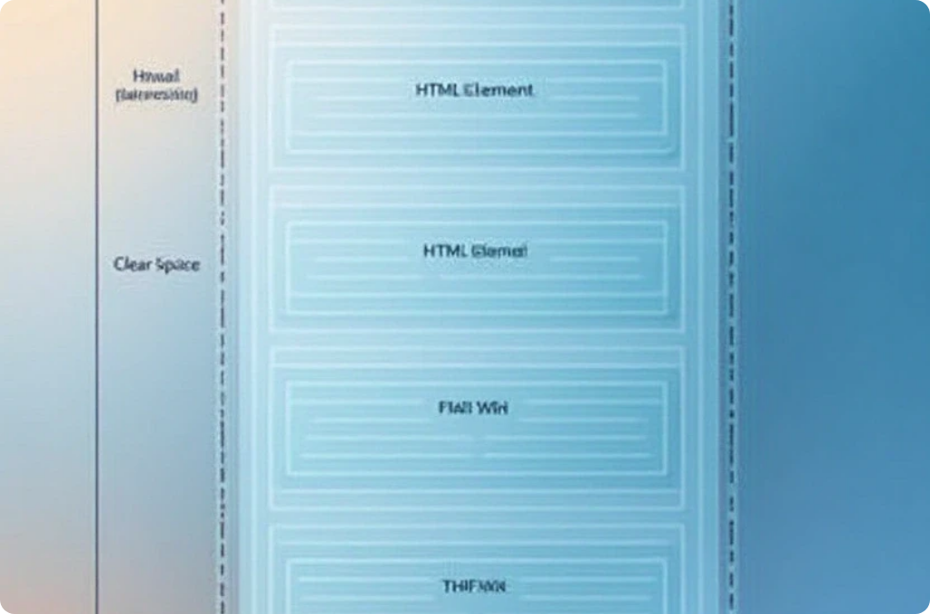
Understanding HTML Elements
Definition and Importance
Common Elements
Nesting Elements
Tags like <div>, <span>, <a>, and <img> serve various functions.
HTML elements can be nested within one another for complex layouts.
HTML elements are the building blocks of web pages, encapsulating content and structure.

Slide 3




HTML5 Semantic Elements
Benefits of Semantic Elements
2
Using semantic elements enhances search engine optimization (SEO) and assists screen readers in interpreting content.
Introduction to Semantic HTML
Semantic HTML5 elements convey meaning about the content they contain, improving readability and accessibility.
1
Example
HTML5 introduced new semantic elements: header, nav, article, footer.
3

Slide 4
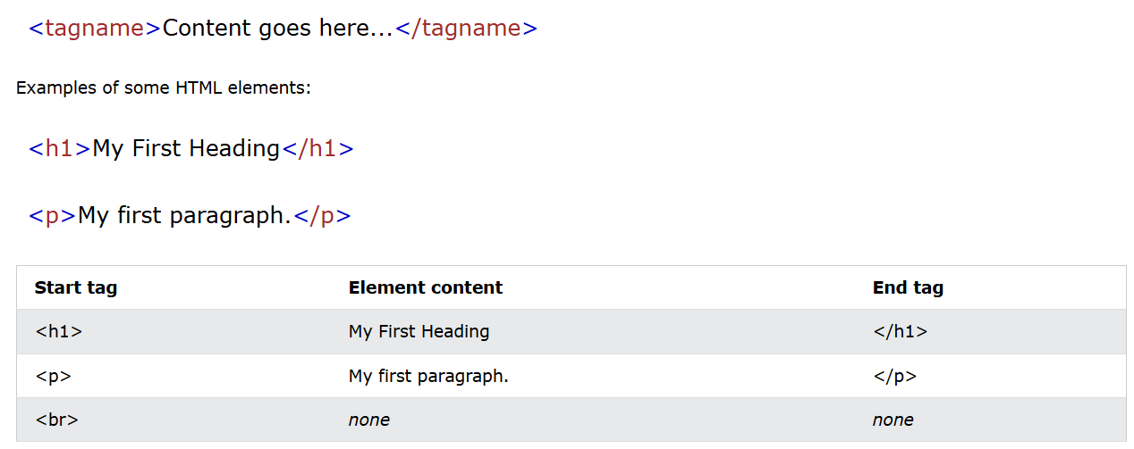
HTML5 Element

Slide 5


Understanding HTML Attributes
Common Attributes
Attributes like class, id, style, and title enhance functionality.
Example:
<a href=“https://www.facebook.com” > Link </a>
<h1 class=“main-heading”> Heading 1 </h1>

Slide 6



HTML Headings: Structure and Importance
Hierarchy of Headings
Accessibility Considerations
Styling Headings
HTML provides six levels of headings, from <h1> to <h6>.
Headings can be styled with CSS while maintaining semantic structure.
Proper use of headings improves accessibility for screen readers.

Slide 7
Understanding HTML Paragraphs
2
Text Formatting within Paragraphs
Use <strong> for bold and <em> for italics to emphasize content.
Defining a Paragraph
The <p> tag groups text into blocks, improving readability.
1
Best Practices
Keep paragraphs concise to enhance readability.
3

Slide 8
HTML Styles Overview
HTML styles are crucial for designing visually appealing and user-friendly web pages. By utilizing inline styles, internal styles, or external stylesheets, developers can create consistent and responsive designs tailored to different devices.
Inline Styles
HTML allows for styling elements directly using the style attribute.
Internal & External Styles
CSS can be included in the head section or linked as an external stylesheet.
Responsive Design
CSS styles adapt layout and appearance based on the device's screen size.

Slide 9

HTML Formatting Essentials
Text Formatting Tags
HTML provides various tags for formatting text.
Special Characters
HTML uses character entities for special characters.
Block vs. Inline Formatting
Understanding block-level vs. inline elements is essential.

Slide 10

HTML Formatting Essentials
Continue…
<b> : Bold text
<strong> : Important text
<i> : Italic text
<em> : Emphasized text
<mark> : Marked text
<small> : Smaller text
<del> : Deleted text
<ins> : Inserted text
<sub> : Subscript text
<sup> : Superscript text

